Slide 1
Real-Time Traffic Management System Using IoT
RNS INSTITUTE OF TECHNOLOGY
BENGALURU - 98
DEPARTMENT OF INFORMATION SCIENCE & ENGINEERING
Final Year Project Work Presentation
Samarth R Aithal : 1RN18IS091
Varun D S : 1RN18IS120
Ronak H Rathod : 1RN19IS406
Ullas S Rao: 1RN19IS410
Internal Guide
Mr. Santhosh Kumar
Asst. Prof, Dept of ISE, RNSIT

Slide 2
AGENDA
Abstract
Introduction
Literature Review
Analysis
System Design
Implementation
Testing
Discussion of Results
National Conference Paper
Conclusion and Future Enhancements
References
Q & A

Slide 3
ABSTRACT
A significant amount of research work carried out on traffic management systems, but intelligent traffic monitoring is still an active research topic with the emerging technologies such as the Internet of Things (IoT) and Artificial Intelligence (AI).
The existing traffic prediction methods mostly dedicated to highway and urban traffic management, and limited studies focused on roads and closed campuses.
Hence our project aims to provide real-time traffic updates on traffic congestion and unusual traffic incidents through roadside message units and thereby improve mobility.

Slide 4
INTRODUCTION
The sustainability and smartness of the smart city concept rely on the technologies adopted to improve the people’s quality of life.
The emergence of the internet of things (IoT) has evolved the concept of smart cities.
Smart traffic infrastructure is an essential component of smart city initiatives because traffic congestion is a severe issue that grows along with city development.
Smart traffic management includes intelligent transport systems with integrated components like adaptive traffic signal controls, freeway management, emergency management services, and roadside units.

Slide 5
INTRODUCTION
Existing System
As of now all the Traffic signals in India are operated manually without any automation
Traffic signals needs a person to controller the flow of traffic with the help of button to switch signal lights
As these signals are controlled by a human this will lead to human errors that leads to traffic congestion etc.
Proposed System
This system allows us to control the traffic signals without Human interference.
These traffic signals are automated and controlled with help of IoT.
These systems are less prone to error and are easy to maintain.

Slide 6
LITERATURE SURVEY
Sl No | Title of the paper | Techniques Used | Contribution | Limitation | Performance
1. | Intelligent Traffic Information System a Real-Time Traffic Information System on the Shiraz Bypass | Video detection and Image processing algorithm to measure traffic-flow according to the average speed of vehicles. | Efficiently measures traffic-flow according to the average speed of vehicles. | Experimental results are promising due to the proximity of determined traffic status by the system compared to the detection done by traffic experts. | Average speed improvement using this system.
2. | Sensor Technologies for Intelligent Transportation Systems | Sensor Technology. | Implementation in-vehicle sensors and its applications which include safety, traffic management. | Lot challenges come with implementation of ITS environment. | Accuracy of 72%

Slide 7
LITERATURE SURVEY
Sl No | Title of the paper | Techniques Used | Contribution | Limitation | Performance
3. | Traffic Measurement and Vehicle Classification with Single Magnetic Sensor | Magnetic sensors detecting Technology | Detect different types of vehicles classification such as non-axle based | Distance of magnetic Sensor, vehicle length must be used for high accuracy | Accuracy of 60%
4. | Vehicle Classification and Speed Estimation Using Combined Passive Infrared/Ultrasonic Sensors | Infrared/Ultrasonic Sensors, Bayesian Network. | Estimate the speed of incoming vehicles. | Error of 5kph vehicle speed estimation. | Accuracy of 90%

Slide 8
LITERATURE SURVEY
Sl No | Title of the paper | Techniques Used | Contribution | Limitation | Performance
5. | Detecting and positioning of traffic incidents via video-based analysis of traffic states in a road segment | Video based detecting, fuzzy-identification method. | Detecting traffic accidents, spiled loads that lead to traffic congestion | This is a experiment proof of efficiency, this has to be implemented in real world. | NA
6. | Portable Roadside Sensors for Vehicle Counting, Classification, and Speed Measurement | Anisotropic magnetic device. (wireless) | Vehicle classification, speed measurements with help of robust algorithm. | Cannot be used for larger traffic junctions. | Accuracy of 95%

Slide 9
LITERATURE SURVEY
Sl No | Title of the paper | Techniques Used | Contribution | Limitation | Performance
7. | Fully autonomous self-powered intelligent wireless sensor for real-time traffic surveillance in smart cities | Self-powered intelligent wireless sensor, iVCCS platform. | Improves roadway efficiency, and maximizes the transportation systems safe, efficient, and more reliable. | Requires proper amount of sunlight and network connectivity. | Approximate Accuracy of 60-70%
8. | Intelligent vehicle counting and classification sensor for real-time traffic surveillance | Novel smart wireless sensor | Efficient and reliable algorithms for vehicle detection, speed and length estimation, classification. | Needs continuous internet connectivity to produce results and can only be used in small juntions | Accuracy of 97%

Slide 10
LITERATURE SURVEY
Sl No | Title of the paper | Techniques Used | Contribution | Limitation | Performance
9. | Moving vehicle classification using wireless acoustic sensor networks | Acoustic signal processing. | Classification system that is able to consider the appearance of (multiple) sensor faults and environmental noise. | This is a experiment proof of efficiency, this has to be implemented in real world. | N/A
10. | A review of computer vision techniques for the analysis of urban traffic | Automatic Video analysis with classical visual surveillance techniques | Vehicle classification, speed measurements with help of robust algorithm. | High traffic density, lower camera angles | Accuracy of 70-80%

Slide 11
Analysis
Problem Identification
Nowadays when we have to travel to a new location we would not know the amount of traffic present along the travelling route.
Currently, there are a few systems that are very expensive but not very accurate.
If we install such systems around, during an emergency it may show roads are empty, but on arrival, roads will be filled.
NodeMCU with InfraRed sensors can be used. This technique is effective cheap, easy to expand and maintain.

Slide 12
Analysis
Objectives
To estimate traffic density on roads using road occupancy measure.
Update residents on real-time traffic messages through Blynk app.
Monitor the road density of smart campuses, especially during peak hours and help to improve mobility.
Provide a real-time dashboard to monitor the traffic updates.

Slide 13
Analysis
System Requirements Specification
HARDWARE REQUIRMENTS
Infrared sensor
NodeMCU
Camera
Jumper wires
SOFTWARE REQUIRMENTS
Windows 7 and above
Arduino IDE
Blynk
Telegram Bot

Slide 14
Analysis
Methodology
1. Automated signalling system
Duration of signals is automatic
Depending on the traffic density in each signal the duration of the signaling will vary.
2. Density traffic detection
In order to detect the density of the traffic at a particular signal, we place a few InfraRed sensors at the distance of 10cm 20cm 30cm.
With these infrared sensors we can find the level of traffic density that is Low, Medium, and High.
This traffic density data will be sent to the user by Wi-Fi which is present in the NodeMCU

Slide 15
Analysis
Methodology
3. Density-based traffic signal control
The traffic signals are controlled depending on the density of the traffic at a particular signal.
Let’s consider an example of a traffic junction, if the traffic density is low then the time of signals will be 20 seconds.
If the density level is medium then the duration of the signal will be 30 seconds.
If the density level is high then the duration of the signal will be 50 seconds.
4. Notification & Cloud Display
All the data that is collected by the NodeMCU is transferred to the user through Cloud.

Slide 16
Analysis
Methodology
So by this the users can get notified about the traffic density.
Depending on the traffic density, the user can decide which route to take.
In case of emergency vehicles, as they can’t stay in traffic, by this feature, they can decide which route has less traffic density and take that route.
5. AI-based camera photo transmission of signals
A camera will be placed near the traffic signal.
This camera is linked to the NodeMCU.
After NodeMCU revises this image, with the help of Wi-Fi it sends this real-time image to the user.

Slide 17
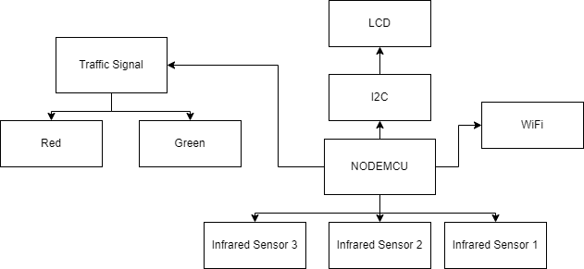
System Design
Architecture Diagram

Slide 18
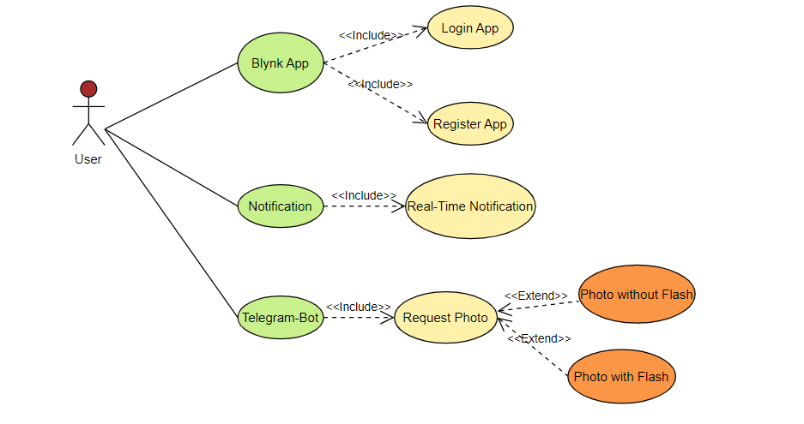
System Design
Use-Case Diagram

Slide 19
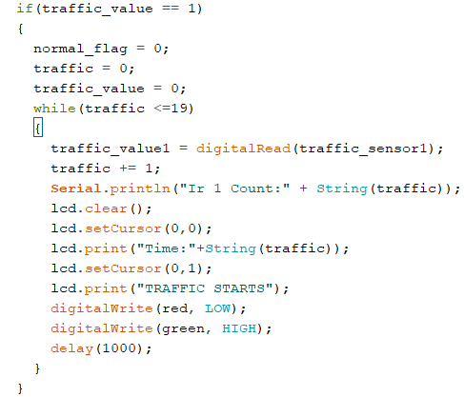
Coding
If sensor 1 is detected

Slide 20
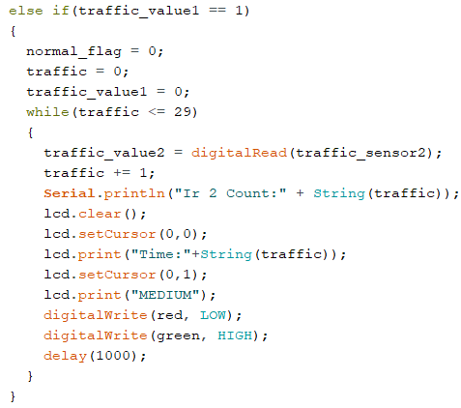
Coding
If sensor 2 is detected

Slide 21
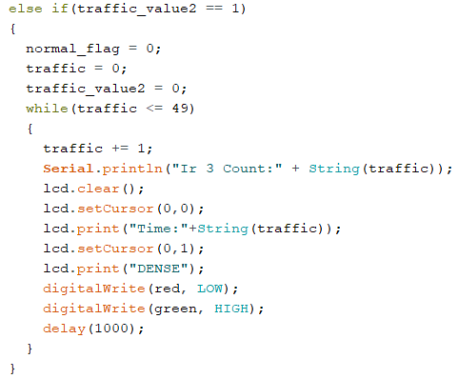
Coding
If sensor 3 is detected

Slide 22
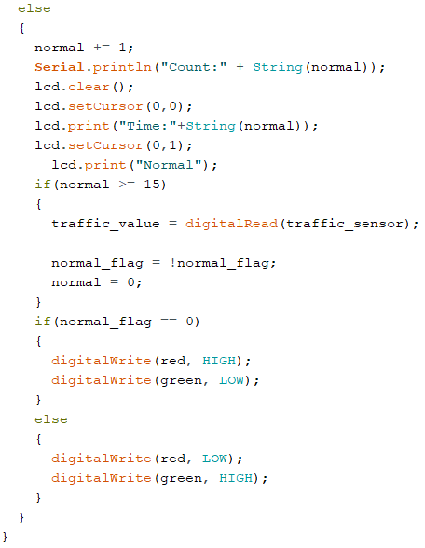
Coding
Duration for Red Light

Slide 23
Testing
In this project we have performed manual testing.
First we are placing toy cars and testing if each sensor is detecting the car.
After confirming that each sensor is detecting the car, we are placing the cars one by one near each sensor and checking whether time duration is increasing or not.
After confirming the working of the system next we will be using telegram bot.
We will be testing separately for photo with and without flash.

Slide 24
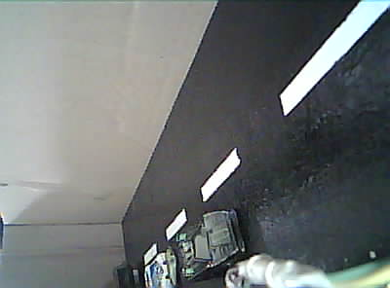
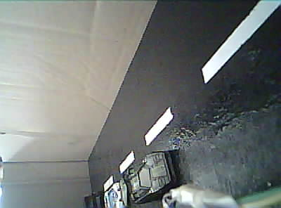
Results and Discussions
Sl. No | InfraRed Sensors | Time
1 | IR1 | 20sec
2 | IR1 && IR2 | 30sec
3 | IR1 && IR2 && IR3 | 50sec
Photo without flash Photo with flash

Slide 25
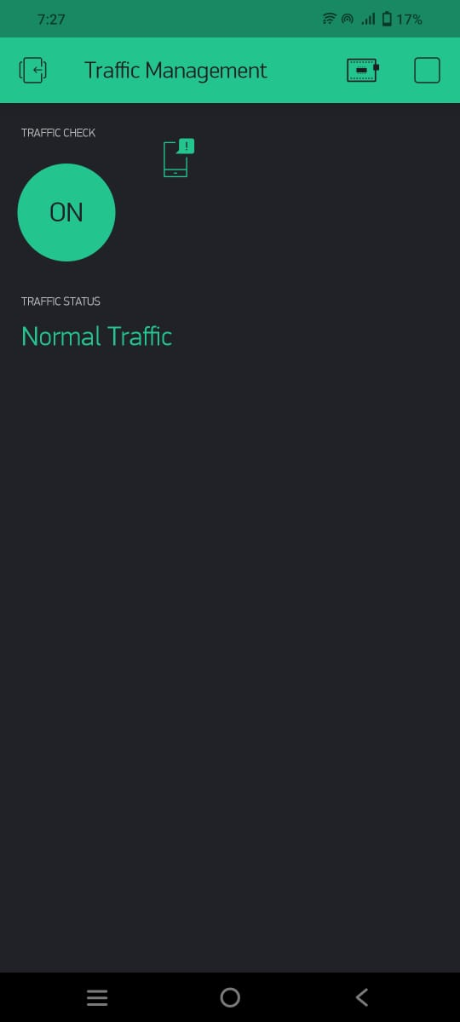


Results and Discussions

Slide 26
CONCLUSIONS
This research provided real-time traffic monitoring for traffic updates through Blynk app.
The users can view messages which will assist in decision making and save their time on roads.
The real-time data is processed by WiFi-enabled microcontrollers and sent to an IoT platform for further actions.
The proposed system is expected to be considered in any smart city initiatives such as a smart university campus or any smart premises.

Slide 27
Future Enhancements
Currently the system is build for only one way. In future we can implement this method in a junction and shift traffic signals using round robin methos.
IR sensor currently only detects if the vehicle is the range of 5cms. In future we can add comparator to it and increase the detection range.
We can use Raspberry-pi or Arduino UNO to increase the performance and enables us to use high-end cameras.
In future we can implement for emergency vehicles so that traffic signal opens up when it detects an emergency vehicle.

Slide 28
REFERENCES
(In IEEE Standard format only)
[1] Sodagaran, N. Zarei, Z. Azimifar, Intelligent traffic information system a real-time traffic information system on the shiraz bypass, MATEC Web of Conferences 81 (2016), 04003, https://doi.org/10.1051/matecconf/20168104003.
[2] L. Sumi, V. Ranga, An IoT-VANET-based traffic management system for emergency vehicles in a smart city, Advances in Intelligent Systems and Computing 708 (2) (2018) 23e31, https://doi.org/10.1007/978-981-10-8636-63.
[3] Atta, S. Abbas, M.A. Khan, G. Ahmed, U. Farooq, An adaptive approach: smart traffic congestion control system, Journal of King Saud University - Computer and Information Sciences (2018), https://doi.org/10.1016/j.jksuci.2018.10.011.
[4] M.R. Islam, N.I. Shahid, D.T. Ul Karim, A. Al Mamun, M.K. Rhaman, An efficient algorithm for detecting traffic congestion and a framework for smart traffic control system, in: International Conference on Advanced Communication Technology, ICACT, 2016, pp. 802e807, https://doi.org/10.1109/ ICACT.2016.7423566. 2016-March
[5] Mohammed Sarrab, Supriya Pulparambil, Medhat Awadalla, Development of an IoT based real-time traffic monitoring system for city governance https://doi.org/10.1016/j.glt.2020.09.004

Slide 29
Question and Answer

Slide 30
THANK YOU

